Slide 1
Module 1-Regular Expression and Finite Automata
By
H. Faheem Nikhat., AP/CSE

Slide 2
Natural Language Processing (NLP) often deals with structured and unstructured text, where recognizing patterns and sequences of words or characters is crucial.
Two fundamental concepts used for these tasks are Regular Expressions (Regex) and Finite State Automata (FSA).
Both are related to formal language theory and automata theory, providing a foundation for many NLP tasks like tokenization, text extraction, and pattern recognition.

Slide 3
1. Regular Expressions (Regex) in NLP
Regular expressions are sequences of characters defining a search pattern, commonly used for text processing in NLP.
They are useful for tokenization, text cleaning, and pattern matching.

Slide 4
Example: Extracting Email Addresses
Suppose you want to extract email addresses from a document:
import re
text = "Contact us at support@example.com or info@company.org“\
Pattern=r”[a-za-Z0-9._%+-]+@[a-zA-Z0-9.-]\.[a-zA-Z]{2,}”
emails = re.findall(pattern, text)
print(emails)
# Output: ['support@example.com', 'info@company.org']

Slide 5
Applications of Regex in NLP
Tokenization – Splitting text into words or sentences.
Named Entity Recognition (NER) – Extracting specific information (like emails, phone numbers, dates).
Text Cleaning – Removing special characters, numbers, or HTML tags.
Pattern Matching – Finding keywords in search engines.

Slide 6
Real-Time Example: Tokenization Using Regex
Tokenization is the process of splitting a sentence into words.
text = "Hello! How are you today?"
tokens = re.findall(r"\b\w+\b", text) print(tokens)
Output:
['Hello', 'How', 'are', 'you', 'today’]
\b\w+\b ensures words are extracted without punctuation

Slide 7
Extracting Phone Numbers
Suppose we need to extract phone numbers from text. A phone number can follow different formats, such as:
123-456-7890
(123) 456-7890
123 456 7890
import re text = "Call me at 123-456-7890 or (987) 654-3210.“
pattern = r"\(?\d{3}\)?[-.\s]?\d{3}[-.\s]?\d{4}“
matches = re.findall(pattern, text) print(matches)

Slide 8
Output: ['123-456-7890', '(987) 654-3210’]
\(?\d{3}\)? → Matches optional parentheses around area code (123) or just 123.
[-.\s]? → Matches a separator (-, ., or space ).
\d{3}[-.\s]?\d{4} → Matches the rest of the phone number.

Slide 9
EX: Removing HTML Tags from Text
Web scraping often results in text containing HTML tags. We can use regex to remove them.
CODE:
text = "<p>Hello, <b>World</b>! Welcome to NLP.</p>"
clean_text = re.sub(r"<.*?>", "", text) print(clean_text)
Output: Hello, World! Welcome to NLP.
<.*?> → Matches anything between < > and removes HTML tags

Slide 10
Extracting Dates
Different date formats exist:
DD/MM/YYYY
MM-DD-YYYY
YYYY.MM.DD
text = "Today's date is 2025.02.03 or 03/02/2025 or 03-02-2025.“
pattern = r"\b\d{2,4}[-/.]\d{2}[-/.]\d{2,4}\b"
dates = re.findall(pattern, text)
print(dates)
Output: ['2025.02.03', '03/02/2025', '03-02-2025']

Slide 11
\d{2,4} → Matches 2 to 4 digits (for year or day).
[-/.] → Matches a separator (-, /, .).
\b → Ensures whole-word match.

Slide 12
2. Finite State Automata (FSA) in NLP
Finite State Automata (FSA) are computational models that process sequences of symbols, making them useful for lexical analysis, tokenization, and spelling correction.
Example: Lexical Analysis in Chatbots
Consider a simple chatbot recognizing greetings like "hi," "hello," and "hey." A Finite State Automaton can process input and transition between states based on user input:
States & Transitions:
Start → "hi"/"hello"/"hey" → Recognized greeting → Response ("Hello! How can I help?")
Any other input → No transition → Default response ("I didn’t understand.")
This FSA ensures the chatbot correctly recognizes and responds to greetings.
Would you like a detailed breakdown of how FSAs work in NLP, including formal definitions and diagrams?

Slide 13
A Finite State Automaton (FSA) is a computational model that processes input sequences by transitioning through states based on a set of predefined rules.
Types of Finite State Automata
Deterministic Finite Automaton (DFA) – Each state has only one possible transition per input.
Non-Deterministic Finite Automaton (NFA) – A state can have multiple transitions for the same input.

Slide 14
Formal Definition of FSA
A Finite State Automaton is defined as a 5-tuple (Q, Σ, δ, q₀, F):
Q → Finite set of states.
Σ → Finite set of input symbols (alphabet).
δ → Transition function (Q × Σ → Q).
q₀ → Start state.
F → Set of accepting (final) states.

Slide 15
Recognizing Simple Greetings
Consider a chatbot that recognizes greetings like "hi", "hello", and "hey".
(q0) --hi--> (q1)
| \
| --hello--> (q1)
| \
| --hey--> (q1)
v (reject)
q0 → Start state.
q1 → Accepting state (valid greeting recognized).
Any other input → Reject state.

Slide 16
def fsa_greeting(input_text):
greetings = {"hi", "hello", "hey"}
state = "q0"
if input_text.lower() in greetings:
state = "q1" # Accepting state
else:
state = "reject"
return "Greeting recognized!" if state == "q1" else "Not a greeting."
# Testing
print(fsa_greeting("hello")) # Output: Greeting recognized! print(fsa_greeting("goodbye")) # Output: Not a greeting.

Slide 17
Real-World NLP Applications of Finite State Automata
Lexical Analysis – Used in compilers and NLP parsers to break down text.
Spell Checking – Identifying whether a word belongs to a valid dictionary set.
Speech Recognition – Mapping phonemes to words using finite state transducers (FST).
Chatbots & Intent Recognition – Identifying user input patterns.

Slide 18
Recognizing Valid Identifiers in Programming
Programming languages have rules for valid variable
names (identifiers).
A variable name:
Must start with a letter or underscore (_).
Can contain letters, digits, or underscores.
Cannot be a reserved keyword (e.g., if, else).

Slide 19
Start → (Letter/_) → Valid Identifier State → (Letter/Digit/_) → Valid Identifier State → (Other Input) → Reject

Slide 20
import re
def is_valid_identifier(identifier):
pattern = r"^[a-zA-Z_][a-zA-Z0-9_]*$"
return bool(re.match(pattern, identifier))
#TestCase
print(is_valid_identifier("valid_var")) # Output: True
print(is_valid_identifier("123start")) # Output: False
print(is_valid_identifier("_privateVar")) # Output: True

Slide 21
^[a-zA-Z_] → The identifier must start with a letter or _.
[a-zA-Z0-9_]*$ → The remaining characters can be letters, digits, or _.

Slide 22
Recognizing Palindromes Using FA
A palindrome is a word that reads the same forward and backward (e.g., "madam", "racecar").
Finite State Diagram
A non-deterministic finite automaton (NFA) is needed because the entire input must be stored before checking.

Slide 23
def is_palindrome(string):
return string == string[::-1]
#Testcases
print(is_palindrome("madam")) # Output: True
print(is_palindrome("racecar")) # Output: True
print(is_palindrome("hello")) # Output: False

Slide 24
Regular Expressions are excellent for extracting structured information from text, such as emails, phone numbers, and dates.
Finite State Automata are better for recognizing structured language patterns, such as variable names, floating-point numbers, and palindromes.

Slide 25
Task : Regular Expressions in NLP
1.1 Extracting Hashtags from Tweets
Objective: Write a Python script to extract all hashtags (#example) from a given set of tweets.
Input: tweets = "Loving this new #AI course! #MachineLearning is so exciting. #NLP“
Output: ['#AI', '#MachineLearning', '#NLP’]
1.2 Validating Strong Passwords
Objective: Write a regex pattern to validate if a password meets the following criteria:

Slide 26
✅ At least 8 characters long ✅ Contains at least one uppercase letter ✅ Contains at least one lowercase letter ✅ Contains at least one digit ✅ Contains at least one special character (@, #, $, etc.)
Input: passwords = ["Pass123!", "weakpass", "Secure#2024", "No$ymbol1"]
Output: Valid: ['Pass123!', 'Secure#2024']
Invalid: ['weakpass', 'No$ymbol1']

Slide 27
1.3 Extracting URLs from Text
Objective: Write a Python script to extract all valid URLs from a given text.
Input: text = "Visit https://www.google.com or http://example.com for more info. Also check www.test.com!“
Output: ['https://www.google.com', 'http://example.com', 'www.test.com']

Slide 28
Hint:
Use the regex pattern
Hint 1: r"#\w+" to match hashtags.
Hint2: ^(?=.*[a-z])(?=.*[A-Z])(?=.*\d)(?=.*[@$!%*?&#])[A-Za-z\d@$!%*?&#]{8,}$
Hint 3: https?://(?:www\.)?\w+\.\w+|www\.\w+\.\w+

Slide 29
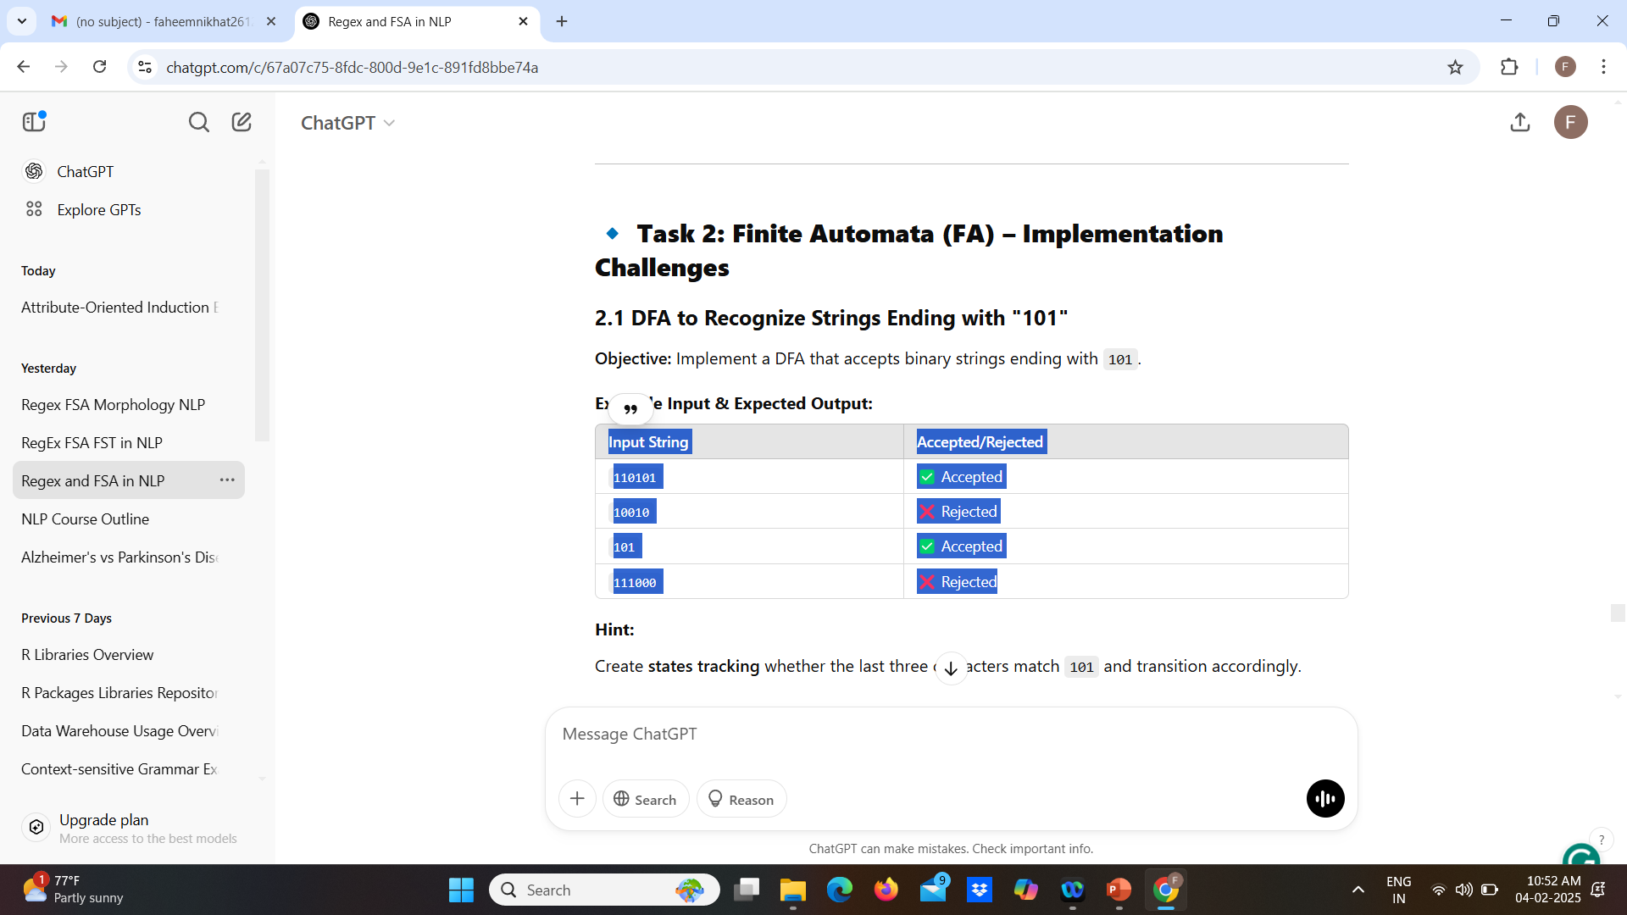
Task 2: Finite Automata (FA) – Implementation Challenges
2.1 DFA to Recognize Strings Ending with "101“
Objective: Implement a DFA that accepts binary strings ending with 101
Example Input & Expected Output:

Slide 30
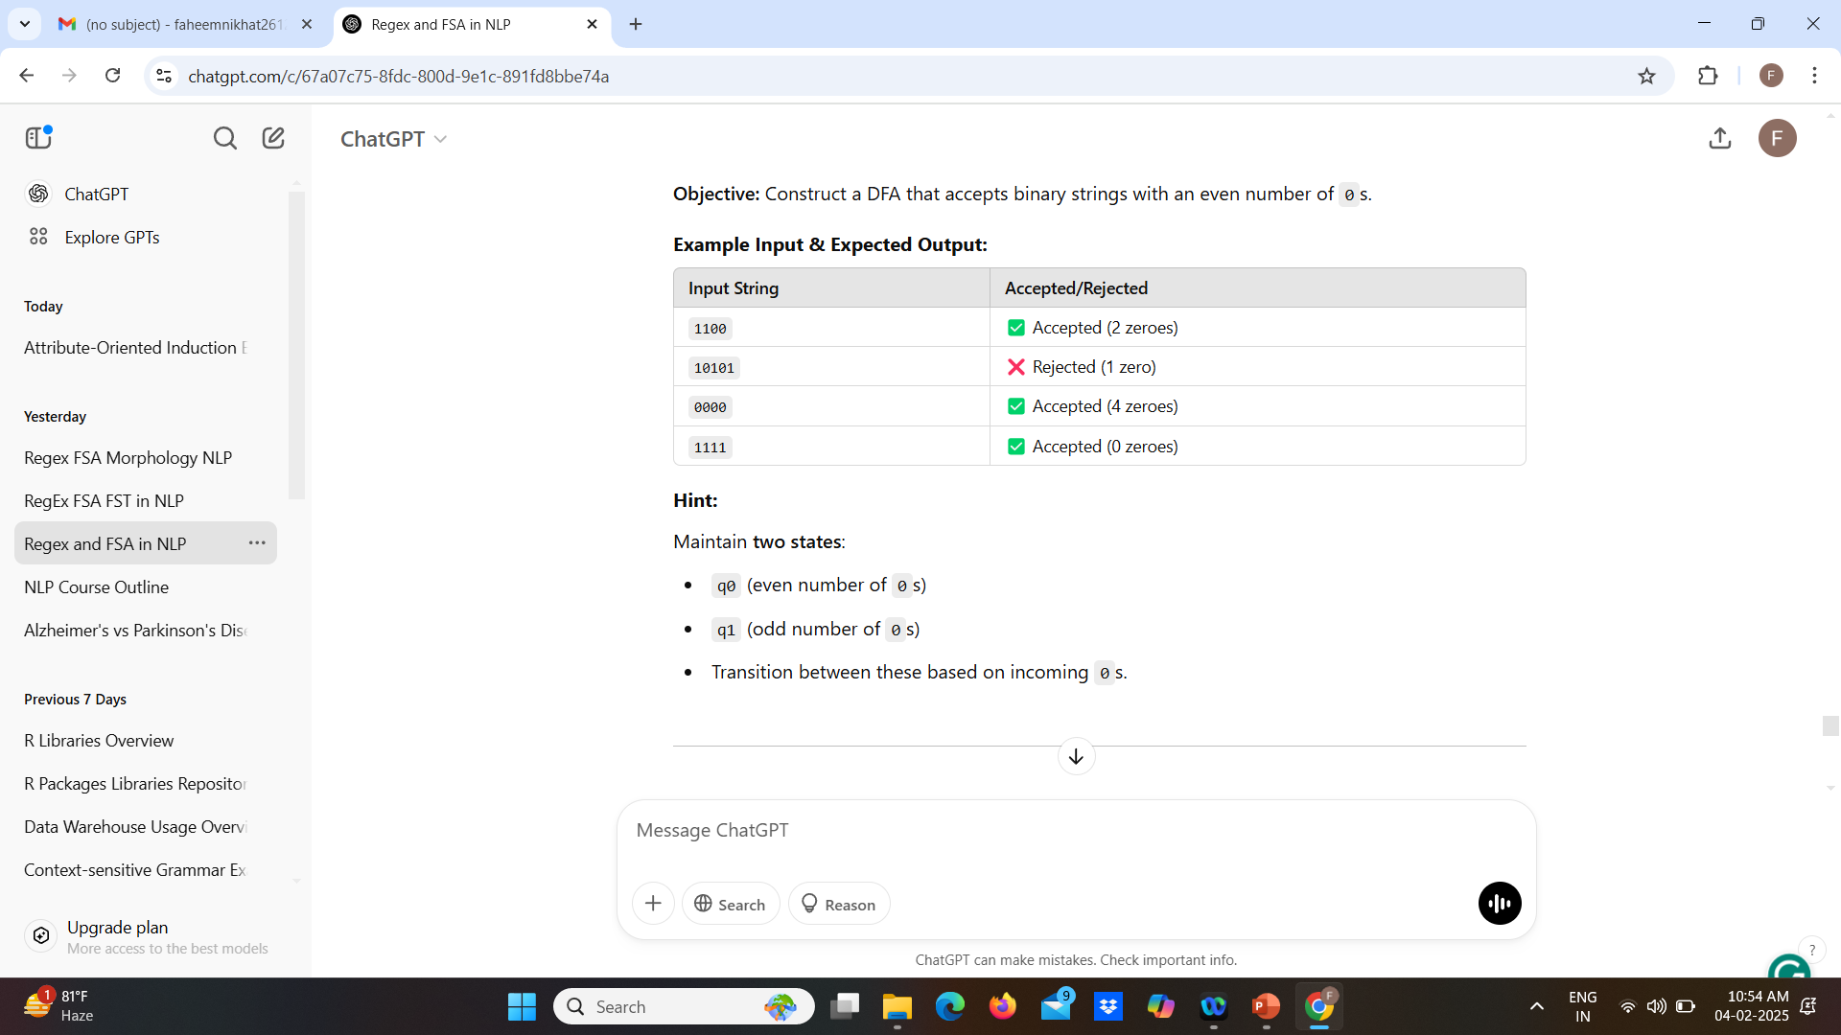
2.2DFA for Recognizing Even-Length Binary Strings
Objective: Construct a DFA that accepts binary strings with an even number of 0s

